Slide 1
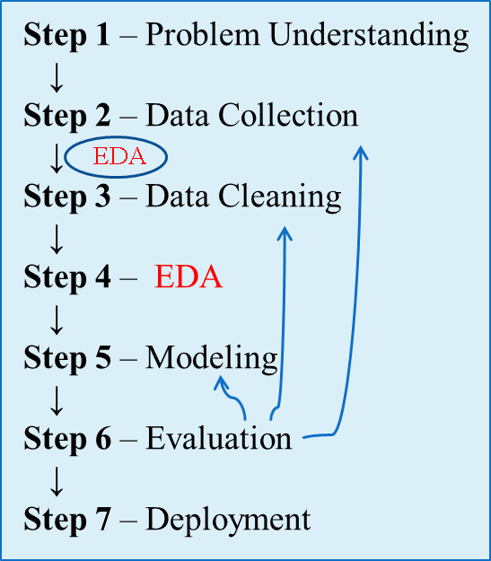
Exploratory Data Analysis (EDA)
Exploratory Data Analysis (EDA) is the process of understanding a dataset before applying statistical models or machine learning algorithms.
EDA answers the question:
What does my data look like, and is it suitable for analysis?

Slide 2
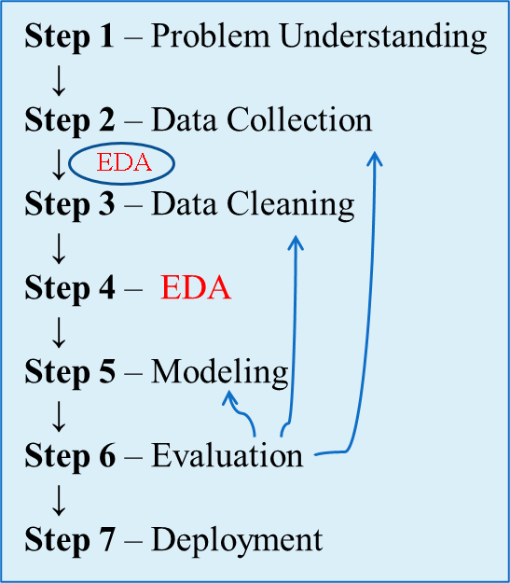
Exploratory Data Analysis (EDA)
1. Load Dataset
↓
2. Understand Structure
↓
3. Check Variable Types
↓
4. Compute Summary Statistics
↓
5. Identify Missing Values
↓
6. Detect Duplicates
↓
7. Detect Outliers
↓
8. Visualize Distributions
↓
9. Examine Relationships
↓
10. Generate Insights
↓
11. Prepare for Data Cleaning/Modeling
A Typical EDA Workflow

Slide 3
Understanding Data
  Before analyzing data, how do we understand what data we have?
  Given the example dataset:
  What information can we obtain from this data?
  Is this enough to understand all students?
  What should we examine before applying machine learning?
StudentID | Age | CGPA | Department
101 | 21 | 3.75 | CSE
102 | 22 | 3.20 | EEE

Slide 4
Understanding Data
Question 1: What information can we obtain from this data?
We can identify:
  Student IDs
  Students' ages
  Students' CGPAs
  Departments they belong to
We can also perform simple analyses such as:
  Average age
  Average CGPA
  Highest and lowest CGPA
  Number of students in each department
Data contains information that can be summarized and analyzed to answer questions.

Slide 5
Understanding Data
Question 2: Is this enough to understand all students?
Answer: No
Reasons:
  Only two students are shown.
  The dataset may not represent the entire student population.
Important variables may be missing:
  Gender
  Semester
  Attendance
  Exam scores
  Family background
  Extracurricular activities
Population vs Sample: A small dataset may provide insights, but it may not fully represent all students.

Slide 6
Understanding Data
Question 3: What should we examine before applying machine learning?
Before building a machine learning model, we should examine:
1. Data Quality
  Missing values
  Incorrect values
  Duplicate records
Example: Age = -5, CGPA = 12.5 Clearly invalid.
2. Data Types
Determine whether variables are:
  Numerical
  Categorical
Example:
Variable | Type
Age | Numerical
CGPA | Numerical
Department | Categorical

Slide 7
Understanding Data
Question 3: What should we examine before applying machine learning?
Before building a machine learning model, we should examine:
3. Dataset Size
  How many rows?
  How many features?
A model may not perform well with very little data.
4. Distribution of Variables
Questions such as:
  Are ages normally distributed?
  Are CGPAs concentrated in a narrow range?

Slide 8
Understanding Data
Question 3: What should we examine before applying machine learning?
Before building a machine learning model, we should examine:
5. Missing Values
Example:
Need handling before modeling.
6. Outliers
Example: CGPA
3.2
3.5
3.7
15.0
Clearly problematic.
Age | CGPA
21 | 3.5
NA | 3.7

Slide 9
Understanding Data
Question 3: What should we examine before applying machine learning?
Before building a machine learning model, we should examine:
7. Target Variable Availability
For supervised learning:
  What are we trying to predict?
Examples:
  Pass/Fail
  CGPA
  Placement Status
Without a target variable, many ML tasks cannot be performed.

Slide 10
Understanding Data: Structured vs. Unstructured Data
Structured Data
  Organized in rows and columns
  Stored in databases, spreadsheets
Unstructured Data
  No predefined format
Examples:
  Emails
  PDFs
  Images
  Audio
  Videos
  Social media posts
ID | Name | CGPA
1 | Rahim | 3.7
Semi-Structured Data
Examples:
  JSON
  XML
Which type is:
  Facebook post?
  Hospital record?
  YouTube video?
  Student database?

Slide 11
Understanding Data: Types of Variables
Variables are the characteristics measured for each observation.
Categorical Variables
Nominal
Examples:
  Gender
  Blood Group
  Department
Ordinal
Examples:
  Satisfaction Level
  Education Level
  Product Ratings
Numerical Variables
Discrete
Examples:
  Number of students
  Number of courses
Continuous
Examples:
  Height
  Weight
  Income
Variable | Type
Age | ?
CGPA | ?
Department | ?
Rating (1–5) | ?

Slide 12
Understanding Datasets
Observation
A row
Feature / Attribute
An input column
Examples:
  Age
  CGPA
Label / Target
Output variable
Example: Pass
Dataset Dimensions
Rows × Columns
Example: 1000 × 20
ID | Age | CGPA | Pass
1 | 20 | 3.5 | Yes
2 | 21 | 3.2 | No

Slide 13
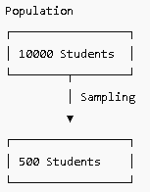
Population vs Sample
Population: All AIUB students
Sample: 500 selected students
Why Sampling?
  Cost
  Time
  Practicality
  Can conclusions from a sample be trusted? Lead into statistical thinking.

Slide 14
Descriptive Statistics
  Descriptive statistics is the process of condensing key characteristics of the dataset into simple numeric metrics. Some of the common quantitative metrics used are mean, standard deviation, and correlation.
  Descriptive statistics can be broadly classified into
  Univariate Exploration: Involves one variable
  Multivariate Exploration: Involves more than one variable

Slide 15
Descriptive Statistics: Measures of Central Tendency
What is Central Tendency?
Measures of Central Tendency describe the center or typical value of a dataset.
The three most common measures are:
  Mean (Average)
  Median (Middle Value)
  Mode (Most Frequent Value)
Example Dataset
  Suppose the quiz marks of 7 students are:
Student | Marks
S1 | 70
S2 | 80
S3 | 75
S4 | 90
S5 | 75
S6 | 85
S7 | 75

Slide 16
Descriptive Statistics: Measures of Central Tendency
Dataset: 70, 80, 75, 90, 75, 85, 75
Mean (Average)
Sum of all marks: 70 + 80 + 75 + 90 + 75 + 85 + 75 = 550
Number of students: n = 7
Mean: 550 / 7 = 78.57
Interpretation
On average, students scored approximately 78.57 marks.
Student | Marks
S1 | 70
S2 | 80
S3 | 75
S4 | 90
S5 | 75
S6 | 85
S7 | 75

Slide 17
Descriptive Statistics: Measures of Central Tendency
Median (Middle Value)
First, sort the data: 70, 75, 75, 75, 80, 85, 90
The middle observation is: 75
Median = 75
Interpretation
Half of the students scored below 75 and half scored above 75.
Student | Marks
S1 | 70
S2 | 80
S3 | 75
S4 | 90
S5 | 75
S6 | 85
S7 | 75

Slide 18
Descriptive Statistics: Measures of Central Tendency
Mode (Most Frequent Value)
Count frequencies:
The most frequent value is:75
Mode = 75
Interpretation
The most common score obtained by students is 75.
Marks | Frequency
70 | 1
75 | 3
80 | 1
85 | 1
90 | 1
Student | Marks
S1 | 70
S2 | 80
S3 | 75
S4 | 90
S5 | 75
S6 | 85
S7 | 75

Slide 19
Descriptive Statistics: Measure of Spread
  Summarizing the dataset can help us understand the data, especially when the dataset is large.
  The mode, median, and mean summarize the data into a single value that is typical or representative of all the values in the dataset, but this is only part of the 'picture' that summarizes a dataset.
  Measures of spread describe how similar or varied the set of observed values are for a particular variable (data item).
  Measures of spread summarize the data in a way that shows how scattered the values are and how much they differ from the mean value.

Slide 20
Descriptive Statistics: Measure of Spread
Dataset A | Dataset B
4, 5, 5, 5, 6, 6, 6, 6, 7, 7, 7, 8 | 1, 2, 3, 4, 5, 6, 6, 7, 8, 9, 10, 11
  The mode (most frequent value), median (middle value*) and mean (arithmetic average) of both datasets is 6. If we just looked at the measures of central tendency, we may assume that the datasets are the same.
  However, if we look at the spread of the values in the following graph, we can see that Dataset B is more dispersed than Dataset A. Used together, the measures of central tendency and measures of spread help us to better understand the data.
  Two datasets can have the same mean, median, and mode, yet be very different.
Measure | Dataset A | Dataset B
Mean | 6 | 6
Median | 6 | 6
Mode | 6 | 6
Range | 4 | 10
SD | 1.13 | 3.16

Slide 21
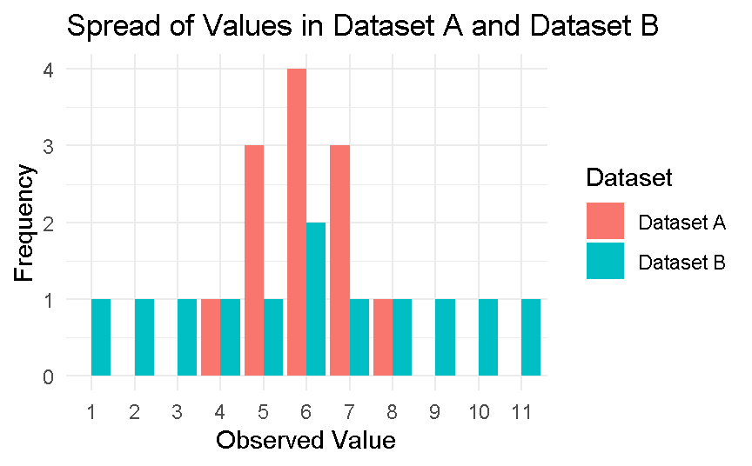
Descriptive Statistics: Measure of Spread
Dataset A | Dataset B
4, 5, 5, 5, 6, 6, 6, 6, 7, 7, 7, 8 | 1, 2, 3, 4, 5, 6, 6, 7, 8, 9, 10, 11
Measure | Dataset A | Dataset B
Mean | 6 | 6
Median | 6 | 6
Mode | 6 | 6
Range | 4 | 10
SD | 1.13 | 3.16
  Measure of spread, sometimes also called a measure of dispersion, is used to describe the variability in a sample or population .There are two common metrics to quantify spread: Range and Deviation.
  Range: The range is the difference between the maximum value and the minimum value of the attribute.

Slide 22

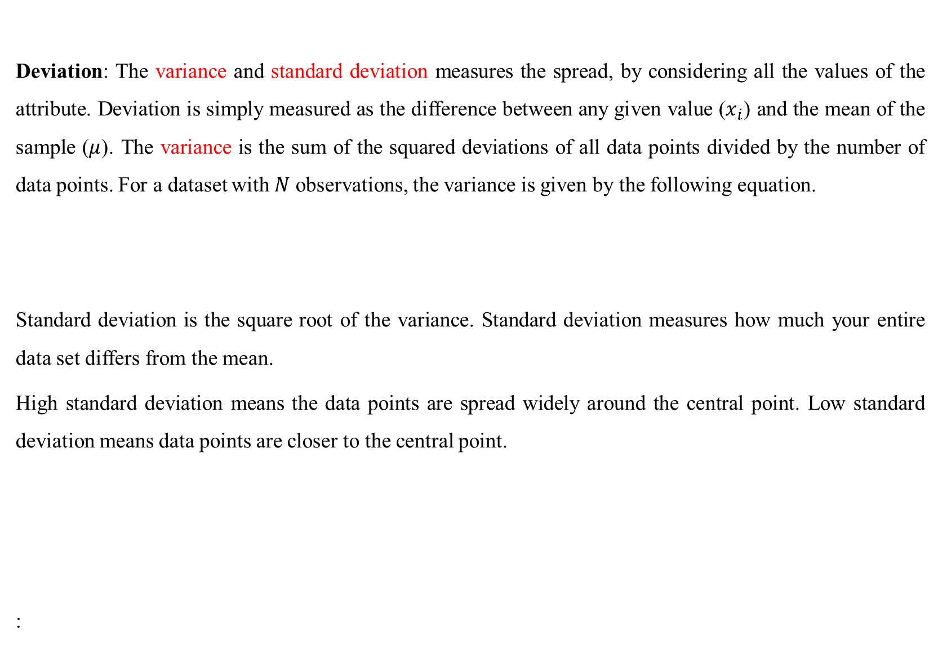
Descriptive Statistics: Measure of Spread
  Deviation: The variance and standard deviation measures the spread, by considering all the values of the attribute. Deviation is simply measured as the difference between any given value ($x_{i}$) and the mean of the sample ($μ$). The variance is the sum of the squared deviations of all data points divided by the number of data points. For a dataset with $N$ observations, the variance is given by the following equation.
  Standard deviation is the square root of the variance. Standard deviation measures how much your entire data set differs from the mean.
  High standard deviation means the data points are spread widely around the central point. Low standard deviation means data points are closer to the central point.
  :

Slide 23
An example with details
  Imagine we have a dataset of exam scores of 10 students:
  Descriptive Statistics
  Mean (Average):
  (85+78+92+67+88+75+90+82+79+95)/10
  =831/10=83.1
  Median:
  Ordered scores: 67, 75, 78, 79, 82, 85, 88, 90, 92, 95
  Median = Average of 5th and 6th values = (82 + 85) / 2 = 83.5
  Minimum Score: 67, Maximum Score: 95
  Range:95 − 67 = 28
Student | Score
A | 85
B | 78
C | 92
D | 67
E | 88
F | 75
G | 90
H | 82
I | 79
J | 95

Slide 24
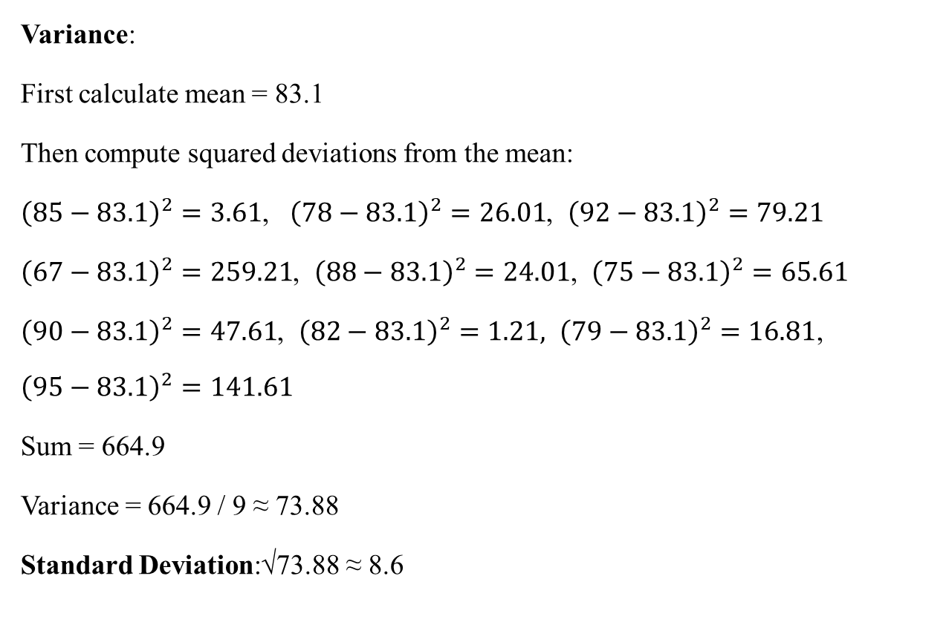
An example with details
  Variance:
  First calculate mean = 83.1
  Then compute squared deviations from the mean:
  ${\left(85−83.1\right)}^{2}=3.61$, ${\left(78−83.1\right)}^{2}=26.01$, ${\left(92−83.1\right)}^{2}=79.21$
  ${\left(67−83.1\right)}^{2}=259.21$, ${\left(88−83.1\right)}^{2}=24.01$, ${\left(75−83.1\right)}^{2}=65.61$
  ${\left(90−83.1\right)}^{2}=47.61$, ${\left(82−83.1\right)}^{2}=1.21, {\left(79−83.1\right)}^{2}=16.81$,
  $${\left(95−83.1\right)}^{2}=141.61$$
  ​Sum = 664.9
  Variance = 664.9 / 9 ≈ 73.88
  Standard Deviation:√73.88 ≈ 8.6
Student | Score
A | 85
B | 78
C | 92
D | 67
E | 88
F | 75
G | 90
H | 82
I | 79
J | 95

Slide 25
Exercise 1
  You have two datasets representing the monthly test scores (out of 100) for students in two different classes:
  Class X: 75, 78, 80, 82, 85, 87
  Class Y: 60, 65, 75, 80, 90, 95
  Tasks:
  1. Calculate the range, variance, and standard deviation for each class.
  2. Which class shows more variability in test scores?
  3. What might this indicate about the performance consistency among students in each class?

Slide 26
Exercise 2
  You are given the following dataset representing the number of hours 10 employees worked
  last week:
  40, 42, 38, 41, 44, 39, 40, 37, 60, 38
  Tasks
  1. Calculate the mean and median of the dataset.
  2. Which measure (mean or median) better represents the central tendency of the data?
  3. Justify your answer considering the effect of any outlier(s).

Slide 27
Descriptive Statistics: Multivariate
  Multivariate Data Exploration refers to the process of analyzing more than two variables simultaneously to understand relationships, patterns, or structures in a dataset.
  It's an important step in exploratory data analysis (EDA), especially when working with real-world datasets where multiple features interact.
  Why Multivariate Analysis?
  To discover interdependencies between variables.
  To identify patterns or trends that are not obvious from univariate or bivariate analysis.
  To reduce dimensionality or detect redundant or highly correlated features.
  To prepare the dataset for predictive modeling.

Slide 28
Descriptive Statistics: Multivariate
  Why Multivariate Statistics?
Many real-world questions involve relationships between variables.
Examples:
Question | Variables
Does study time affect CGPA? | Study Hours, CGPA
Does age influence salary? | Age, Salary
Does advertising affect sales? | Advertising Cost, Sales
Does temperature affect electricity usage? | Temperature, Energy Consumption

Slide 29
Descriptive Statistics: Multivariate
Covariance: Covariance measures whether two variables tend to move together.
Interpretation
Covariance | Meaning
Positive | Variables increase together
Negative | One increases while the other decreases
Near Zero | Little linear relationship
Student | Study Hours (X) | CGPA (Y)
1 | 10 | 2.8
2 | 15 | 3.0
3 | 20 | 3.2
4 | 25 | 3.6
5 | 30 | 3.9
Example Dataset →
Observation:
As Study Hours increase, CGPA also increases.
Therefore: Covariance > 0

Slide 30

Descriptive Statistics: Multivariate
Correlation: Covariance is difficult to interpret because its magnitude depends on units. Correlation solves this problem.
Correlation measures the strength and direction of a relationship.
Range: $−1 ≤ r ≤ +1$
Study Hours | CGPA
10 | 2.8
15 | 3.0
20 | 3.2
25 | 3.6
30 | 3.9
Correlation | Interpretation
+1 | Perfect positive relationship
+0.8 | Strong positive relationship
+0.5 | Moderate positive relationship
0 | No linear relationship
-0.5 | Moderate negative relationship
-0.8 | Strong negative relationship
-1 | Perfect negative relationship
Strong positive correlation.

Slide 31
Descriptive Statistics: Multivariate
Remember: Correlation does not mean causation. The phrase “correlation does not imply causation” is often used in statistics to point out that correlation between two variables does not necessarily mean that one variable causes the other to occur.
Example 1: Ice Cream Sales & Shark Attacks ?.
Example 2: High School Graduates vs. Pizza Consumption ?
Example 3: Master’s Degrees vs. Box Office Revenue ?

Slide 32
Descriptive Statistics: Multivariate
Cross-Tabulation (Categorical Variables)
Used when both variables are categorical.
Which group has higher pass rates?
Is there a relationship between Gender and Pass Status?
Gender | Passed
Male | Yes
Female | Yes
Male | No
Female | Yes
Gender | Yes | No
Male | 1 | 1
Female | 2 | 0

Slide 33
Descriptive Statistics: Multivariate
Grouped Descriptive Statistics
Instead of computing one mean for everyone, compute means for groups.
This provides richer information than a single overall mean.
Department | CGPA
CSE | 3.7
CSE | 3.5
EEE | 3.1
EEE | 3.3
Department | Average CGPA
CSE | 3.6
EEE | 3.2

